Slide 1
Identification of Handwritten Digits Using the MNIST Dataset
Group Members:
Full Name | UNT ID | E-Mail
Bharath Kumar Sunkari | 11504574 | bharathkumarsunkari@my.unt.edu
Neeraj Mothukuri | 11549636 | dhamodarneerajmothukuri@my.unt.edu
Sai Krishna Dasineni | 11549138 | saikrishnadasineni@my.unt.edu
Sampath Potluri | 11516629 | sampathpotluri@my.unt.edu

Slide 2



Table of Contents:
Abstract
Project Goal
Major Requirements
Stages of Project
UI Representation
Team Collaboration
Resources

Slide 3

Abstract
Humans detect and visually experience the world around them using their eyes and brains. Computer vision aims to make computers capable of observing and evaluating images in the same way that humans do. One of the difficult approaches in pattern recognition applications is recognizing handwritten numbers.
Digit recognition applications include postal codes or data form filling, to mention a few. The primary goal is to create a model that can better recognize and determine a handwritten number based on its appearance. We're using an MNIST, which is a dataset of the MNIST database for our project.

Slide 4
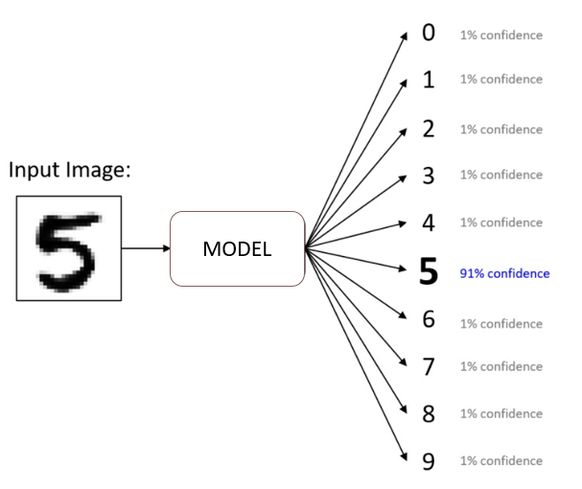
Project goal
To create a machine learning model which predicts the hand-written digits collected from the MNIST dataset.
The goal is to recognize handwritten digits, which means we have 10 classes to predict (0 to 9).

Slide 5
Major Requirements
For creating a model:
Keras- Keras is an api from tensorflow used for loading dataset and developing model
Scikit-Learn – It is used for train_test_split, and for evaluating model performance
CNN Algorithm - best accuracy on image classification
For developing a User Interface:
React JS - It's a free JavaScript library for creating single-page user interfaces.
Flask - Flask is a simple and lightweight Python web framework that provides essential tools and capabilities for developing online applications in Python.

Slide 6
Software's Used
Visual Studio Code – In our project VS Code is used to develop the single page web application with the help of React.JS and Flask web frameworks. As a result, it's much easier to demonstrate the results simply by uploading an image of a handwritten digit and clicking Predict to see if we're obtaining the exact value as intended.
Anaconda – we used anaconda as we know we will in the need of numerous data science packages for computing, management of the development and deployment of the project and in anaconda we used Jupiter notebook for writing the code and to develop the models.

Slide 7
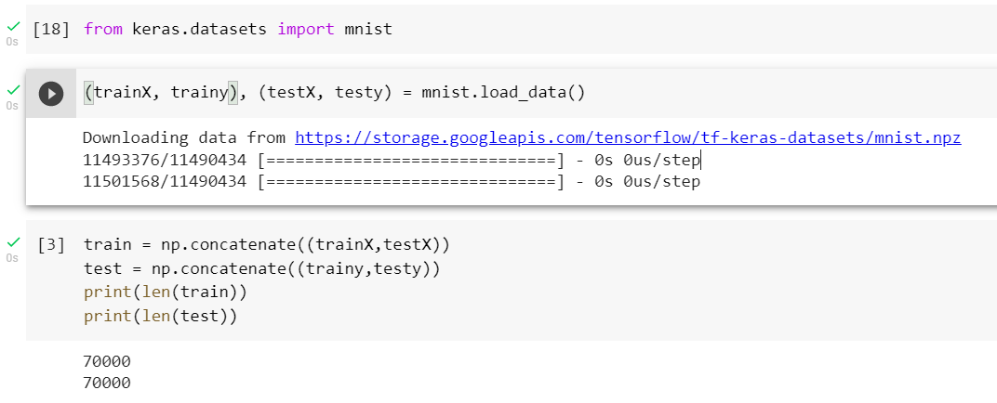
Stages of project
Loading the dataset
Here we have done loading the dataset from Keras

Slide 8
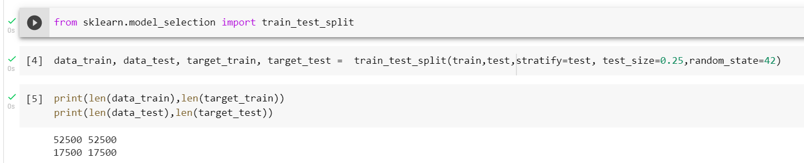
Stages of project
Loading the dataset
Using scikit-learn, we split the data into Training and Testing for the model. which is 52,500 images for training and 17,500 images for testing

Slide 9
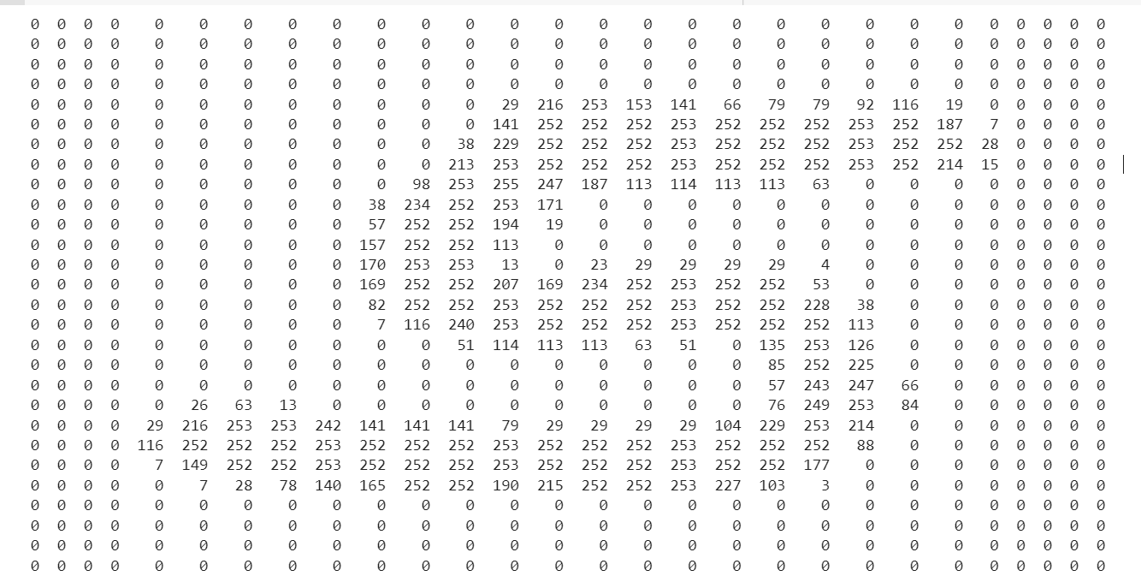
Stages of project
About the dataset
Images are kept in the form of a
matrix of integers, which are
referred to as pixel values.

Slide 10
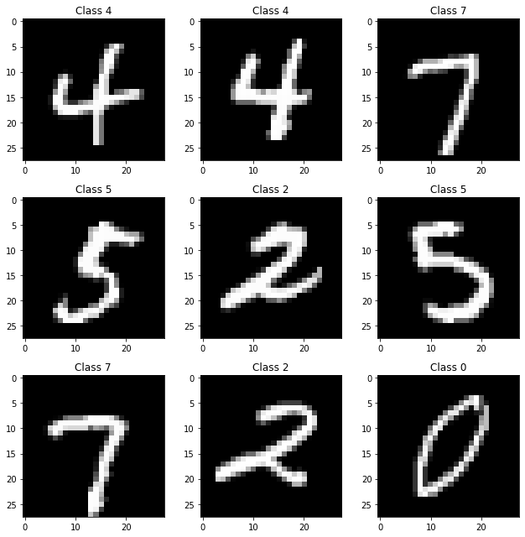
Stages of project
About the dataset
Each image in the data set is a grey-scale image represented
as a 28x28 pixel square, that means each image has total of
784 pixels.

Slide 11
Stages of project
Preprocessing
There are 4 steps in preprocessing:
Reshaping: Reshaping both training and testing image arrays from (52500,28,28), (17500,28,28) to (52500,28,28,1), (17500,28,28,1) where Number 1 indicates gray scale image.
Type Conversion: Converting type of both training and testing image arrays from int to float32
Normalization: Normalize the pixel values to lie between 0 and 1 by dividing with 255.0
One-hot encoding : We do encode the labels for both train and test images, where in an array of ten 0’s the label number will be stored in that position.
For example, label 7 will be stored as [0,0,0,0,0,0,0,1,0,0]

Slide 12
Stages of project
Defining the model
Created model using convolutional neural network (CNN) machine learning algorithm
Pixel array serves as input layer which has 28*28=784 pixels and then there are 2 hidden 512 node layers and 10 different category classes serves as output layer
Keras Sequential Model is used as model architecture
In last layer, softmax activation is used which converts the input values of an neuron into a probability distribution.

Slide 13
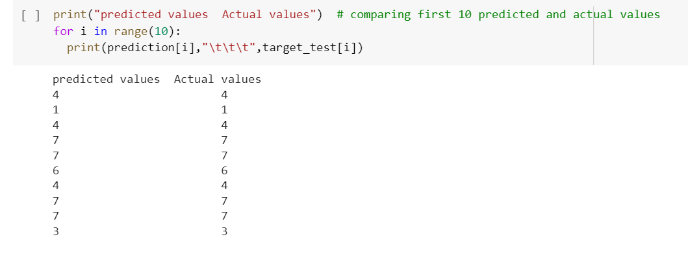
Stages of project
Model performance
Displaying first 10 predicted and actual labels

Slide 14
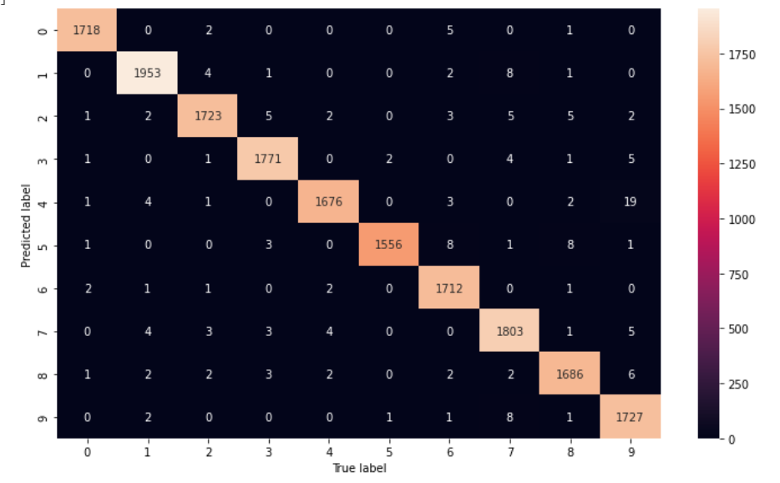
Stages of project
Model performance
Confusion matrix:
It is an N x N matrix used for
evaluating the performance of
a classification model, where N
is the number of target classes.

Slide 15
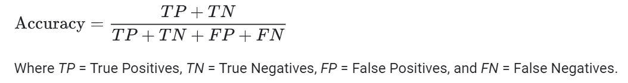
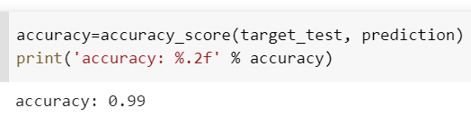
Stages of project
Model performance
Accuracy : It is used in classification problems used to tell the percentage of accurate predictions.

Slide 16
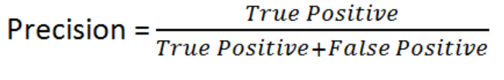
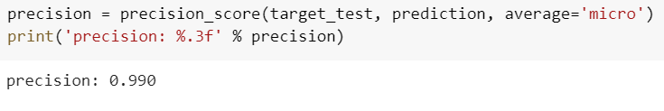
Stages of project
Model performance
Precision : Of all the labels that model predicted, what is the percentage of them are correct

Slide 17
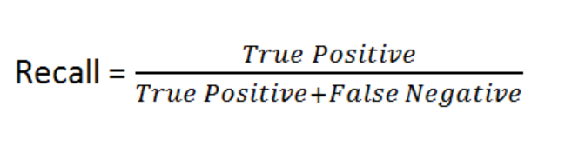
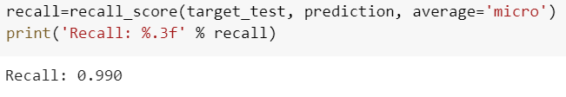
Stages of project
Model performance
Recall : Of all the actual labels, what is the percentage of them are predicted correctly

Slide 18

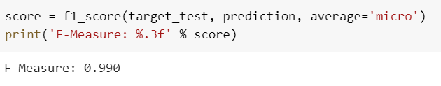
Stages of project
Model performance
F1 Score: It combines the precision and recall of a classifier into a single metric by taking their harmonic mean

Slide 19
User Interface
We have taken of advantage of developing the User-Interface where we can present the project easily understandable.
To develop the web page, we have used React.js which is well known for developing the single page web applications and Flask web-framework, because the react and flask is having very good response for their combination in developing the web applications.

Slide 20
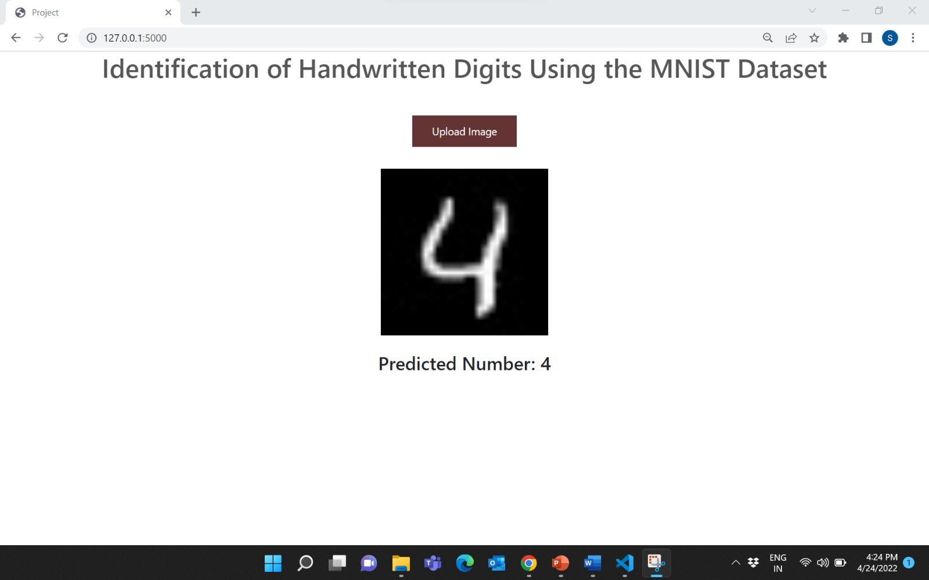
User Interface Output

Slide 21
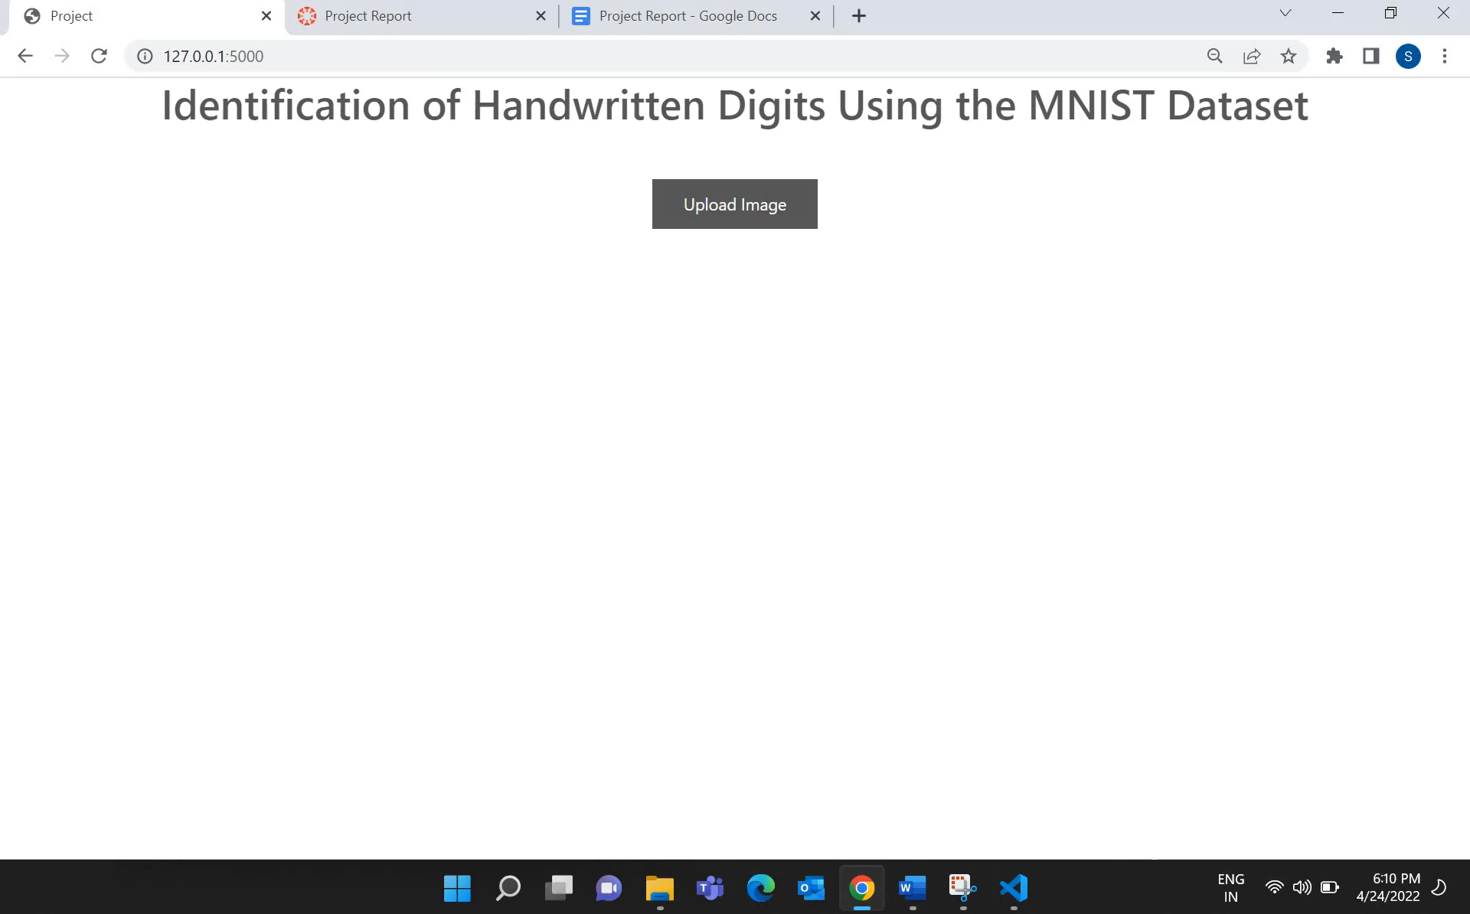
User Interface Output(Screen Recorded)

Slide 22
What’s next?
As our current design can take the input of one image at a time and predict a single digit at a time, we think our design can take an image that consists of more than 1 digit and predict all the digits in the image.

Slide 23
Team collaboration
Bharat Kumar Sunkari: Worked effectively in choosing the dataset and pre-processing the data and involved while developing the model.
Neeraj Mothukuri: Took initiative to develop the machine learning model from the stage of the choosing the right algorithm and training and testing the data for the best results.
Sai Krishna Dasineni: Involved in developing the model and in addition developed a User Interface using web-frameworks, where the user can upload the image and predict the hand-written digit.
Sampath Potluri: Worked on evaluating the model performance like Plotting the Confusion Matrix, Accuracy Score, Precision, Recall and F1 Score.
In Overall, all the members contributed to documentation for the project and created a GIT Repository to access the project files.

Slide 24

THANK YOU

